Slide 1
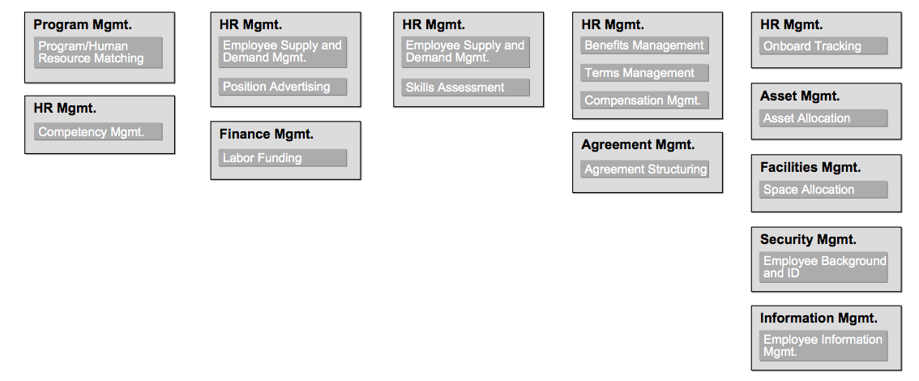
Business Capability Mapping e.g. – Chief Dentist wanting to hire an assistant Dentist
Identifies, categorizes, and decomposes the business capabilities required for the business to have the ability to deliver value to one or more stakeholders

Slide 2
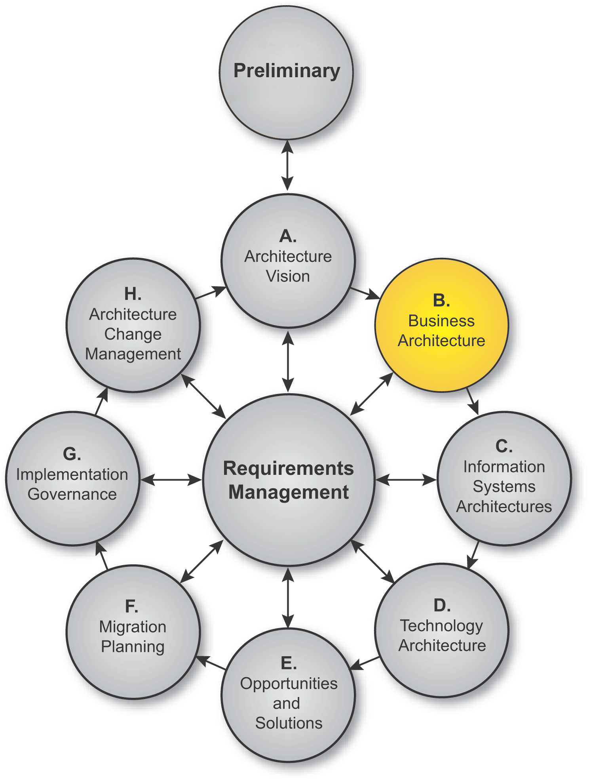
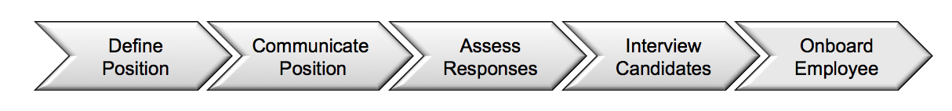
Value Stream Mapping
The breakdown of activities that an organization performs to create the value being exchanged with stakeholders
Notes:
Applying Value Streams
Value streams provide valuable stakeholder context into why the organization needs business capabilities, while business capabilities provide what the organization needs for a particular value stage to be successful. A value stream can be analyzed within the scope of the project through heat mapping (by value stream stage) or by developing use-cases around a complete definition of the value stream (see Baseline Example in the TOGAF® Series Guide: Value Streams). A project might focus on specific stakeholders, one element of business value, or stress some stages over others to develop better requirements for solutions in later phases. A recommended technique is mapping relationships between the stages in a value stream to business capabilities, and then performing a gap analysis for capabilities in the context of the business value achieved by the value stream for a specific stakeholder.
A value stream (a simple example of which is shown on this slide which is about recruiting an employee) is depicted as an end-to-end collection of value-adding activities that create an overall result for a customer, stakeholder, or end-user. In modeling terms, those value-adding activities are represented by value stream stages, each of which creates and adds incremental stakeholder value from one stage to the next.

Slide 3
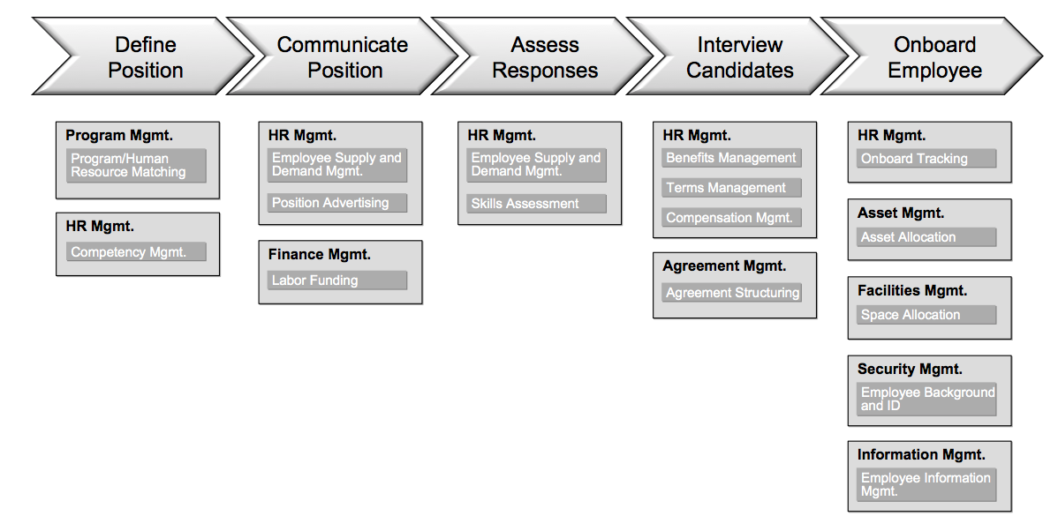
Mapping Value Streams to Business Capabilities
Notes:
Applying Value Streams
A recommended technique is mapping relationships between the stages in a value stream to business capabilities, and then performing a gap analysis for capabilities in the context of the business value achieved by the value stream for a specific stakeholder.

Slide 4


Procurement : Centralize or F1
Receive Orders
Select National
Vendor
Order for All

Slide 5
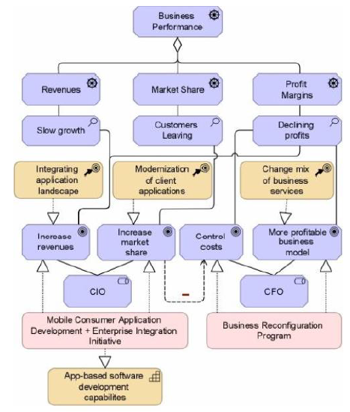
ARCHINSURANCE CIO and CFO Plan Realization
It shows the CIO plan as the first
two courses of action, and the goals they realize, and the CFO plan as a single
course of action with the goal that can realize. It shows the CIO and CFO as
stakeholders associated with conflicting goals (the CIO wants to increase market
share which conflicts with the CFO goal to control costs) that are in turn associated
with different drivers (business performance, which consists of the drivers
revenues, market share, and profit margins) and their assessments (slow growth,customers leaving, declining profits). It also shows a new IT capability being realized. The CIO and CFO goals require different work packages for their
realization.

